Slide 1
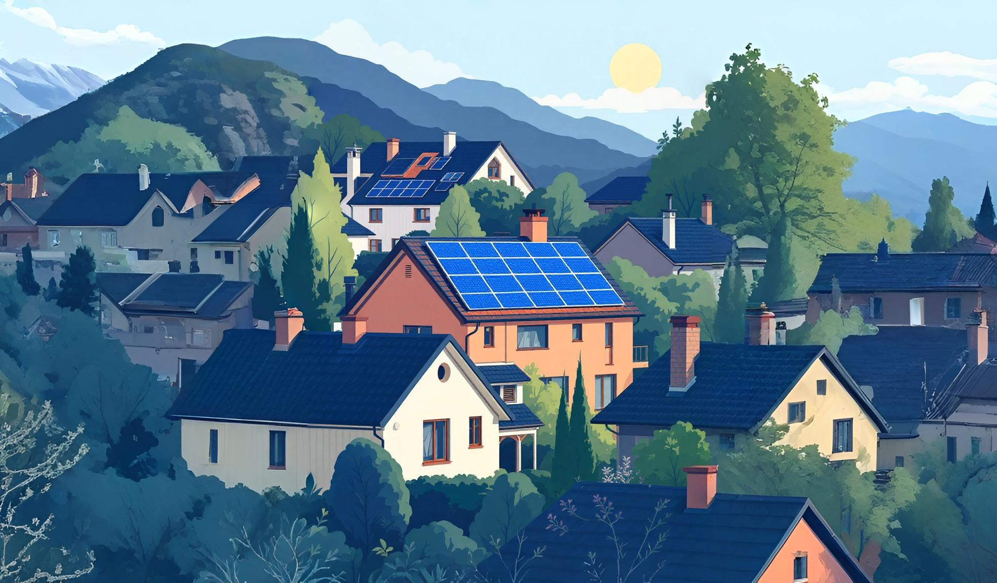
Smart Energy Sharing Grid
The Future of Power Distribution
By:- Rajesh Rana
(24CSEAIML015)

Slide 2
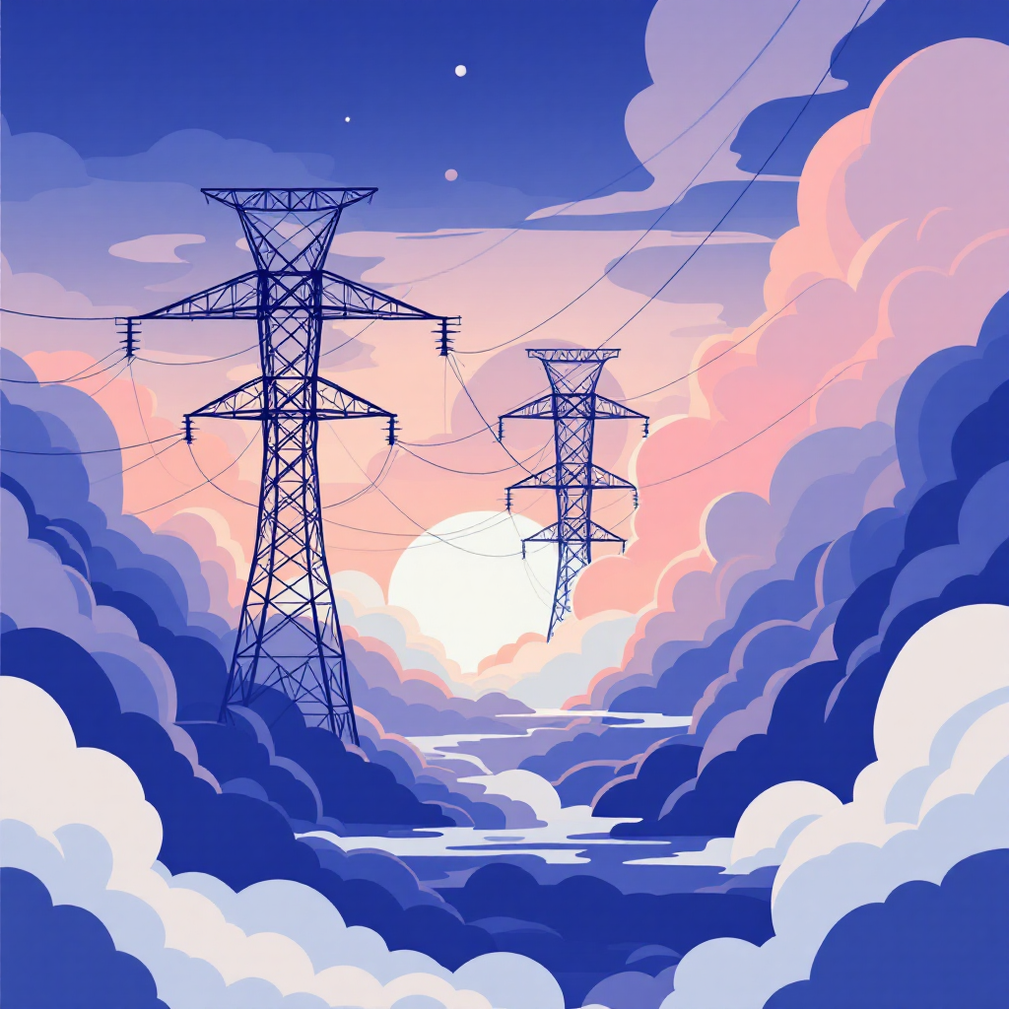

Problem Statement
Homes with solar panels produce excess energy during the day.
Surplus energy is often wasted or sold back to the grid at low rates.
Meanwhile, neighbors without solar pay high electricity bills.
Centralized grids cause energy loss (≈ 6–8% during transmission).

Slide 3

Our Revolutionary Solution
Peer-to-Peer Energy Trading
IoT Smart Meters
Neighbors share electricity directly, bypassing traditional utility middlemen
Real-time monitoring and measurement of energy production and consumption
Blockchain Security
Transparent, tamper-proof smart contracts record every energy transaction
The Smart Energy Sharing Grid transforms surplus solar power into community assets, creating a decentralized network where clean energy flows efficiently between neighbors.

Slide 4
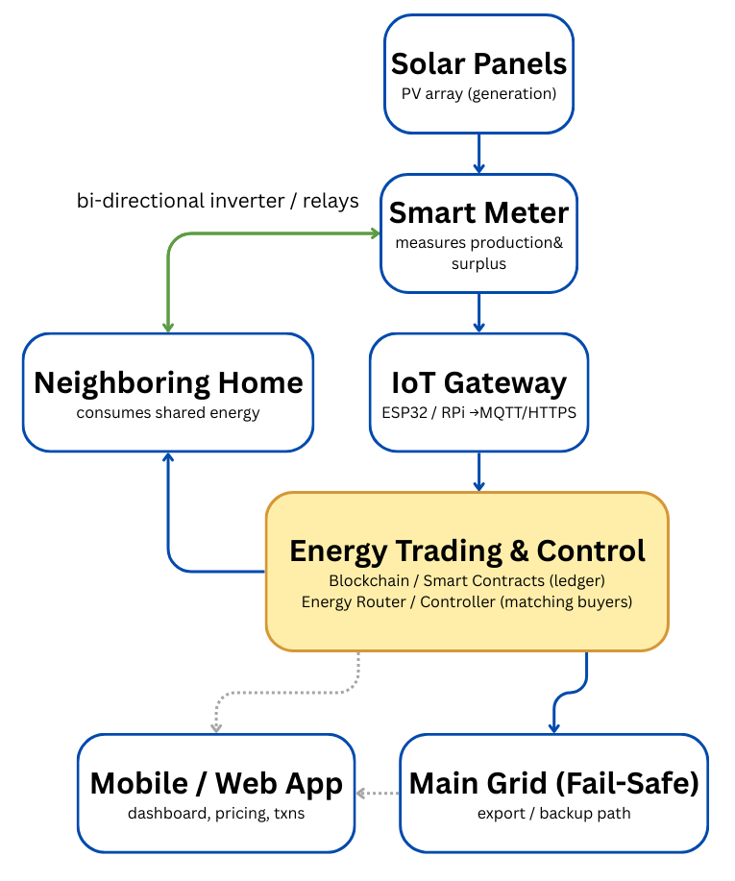
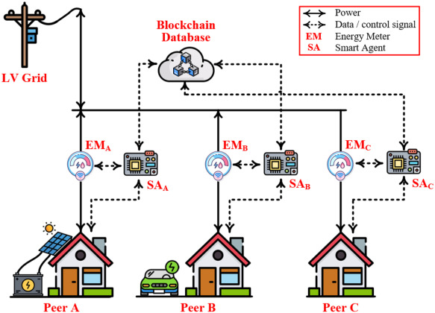
How It Works

Slide 5
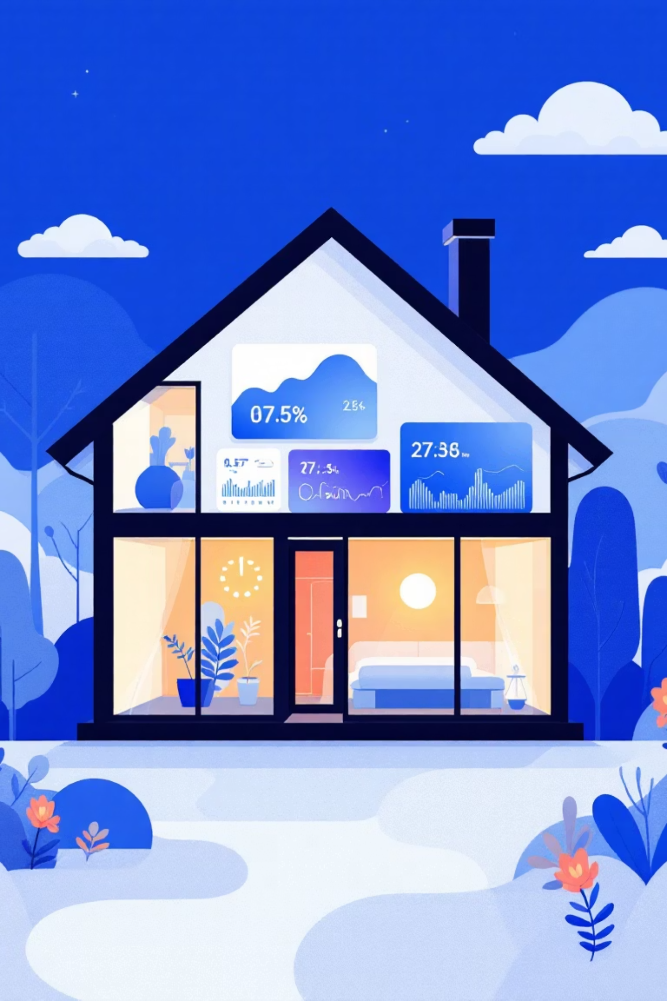




Powerful System Features
Live Monitoring
Dynamic Pricing
Real-time visibility into energy production, consumption, and trading activities
Market-driven rates make electricity affordable for buyers while profitable for sellers
Direct Trading
Fail-Safe Mode
Peer-to-peer transactions eliminate utility middlemen and reduce costs
Automated grid backup ensures no renewable energy goes to waste

Slide 6
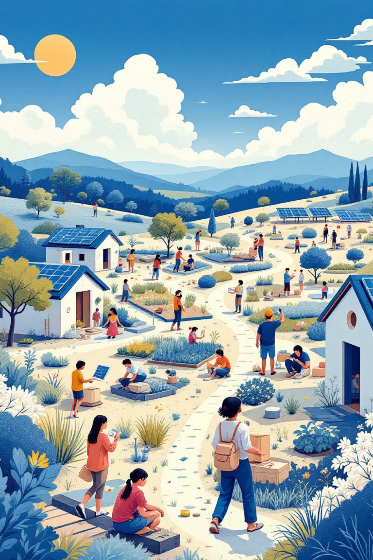




Transformative Benefits
Environmental Impact
Maximizes renewable energy utilization, significantly
reducing carbon emissions and fossil fuel dependence
Economic Savings
Households save on electricity costs while solar producers
earn revenue from surplus energy sales
Grid Efficiency
Eliminates transmission losses and improves overall power
grid stability through distributed generation
Community Building
Neighbors collaborate in clean energy initiatives,
fostering sustainable local partnerships

Slide 7
Thank You

